Slide 1
ISF Flow – BOT Integration Macro/Python/Java

Slide 2
ISF BOT Creation Flow
BOT Pre-requisites
Identify WF & Step
Create request for BOT ID
WF Owner Approval for BOT
Test BOT
SP Deploys BOT
BOT ID Created
BOT Status
Assigned
Tested
Approved
Deployed
Java 1.8 64 Bit version (server version)
ISF Setup Install
Macro/Python Code change for ISF
BOT request to be raised from WF Step to be automated
“Creation” Option from BOT Store to be used
BOT to be tested from BOT Store window
Once test successful, BOT needs to be approved by WF owner in ISF
SP can deploy BOT in ISF after testing and approval is done
Once BOT id is created, it can be mapped to any WF step
Note: Once a BOT request has been raised for a manual step, ISF will not accept another BOT request for same step.
Detailed Flow with Snapshots
ISF Sharepoint for Videos

Slide 3
ISF Automation Pre-requisites
Below steps are required before any Automated Step (BOT) can be executed or integrated
User’s machine should have Java 1.8 64 Bit version (server version). Take help from Ericsson IT if required.
Download the ISF setup file from ISF page:
Run the exe file and set up the application
Application will be installed in C drive
Run this application.
ISF Setup

Slide 4
ISF Integration of Macro BOTs

Slide 5
ISF BOT Guideline – Excel Macro
Macro file name should not contain any Blank spaces and Special characters (Can use underscore).
Your macro code should be written on Module level, it should not be on sheet level.
If your code is on sheet level then do either of any one changes in your code as below:
Either create a new module and call your sheet code from new module.
Or shift your Sheet level code in Module.

Slide 6
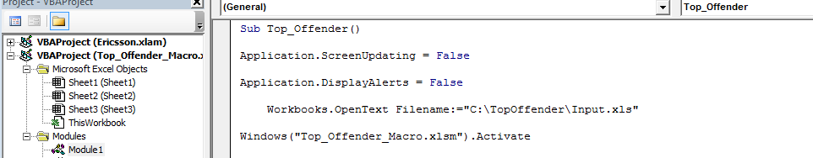
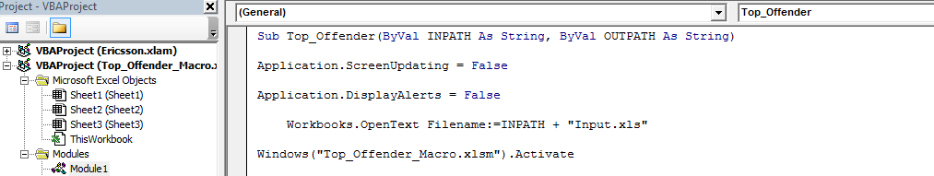
Required Macro Changes for Input
Need to remove all hardcode Input Paths from your code. Examples as below:
Old code:
New code:
As shown in above images, please changes your hard coded path accordingly. And make changes in your complete code to remove hard coded path for input path.

Slide 7
Required Macro Changes for Output
You must save macro output in OUTPATH variable to remove all hardcode Output Paths as shown in below code:
Old code:
New code:

Slide 8
Required Macro Changes if Closing Macro File
If you are closing your macro file programmatically at last step of macro then comment or remove it as in below example:

Slide 9
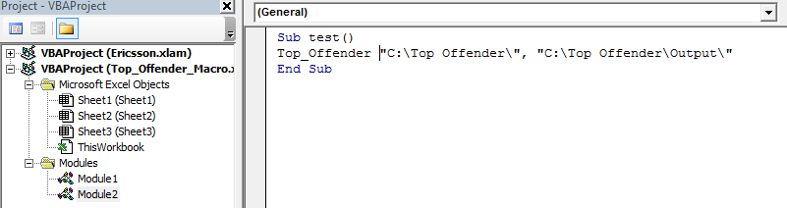
Unit Testing of Macro After Changes
Before sharing your macro code to ISF-RPA team, do unit testing of your macro for desired results. For unit testing use below steps:
Step1- Create a new module.
Step2- Create a new method in this module and call your main method from this this new method.
Step3- Pass two parameters when calling your main method.
Step4- After successful macro execution, please check your desired output in OUTPATH folder.

Slide 10
ISF Integration of Python BOTs

Slide 11
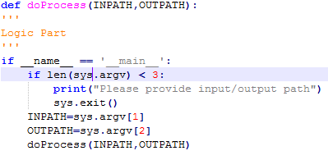
BOT Guideline – Python
Your python code should not contain any UI related code, if any it needs to be removed.
The python code should have main method accepting 2 parameters as below snippet-

Slide 12

Required Python Changes for Input
Need to remove all hardcode Input Paths from your code. Examples as below:
Old code:
New code:
As shown in above images, please changes your hard coded path accordingly. And make changes in your complete code to remove hard coded path for input path.

Slide 13
Required Python Changes for Output
Your python code should not contain any UI related code, if any it needs to be removed.
The python code should have main method accepting 2 parameters as below snippet-

Slide 14
ISF Integration of Java BOTs

Slide 15
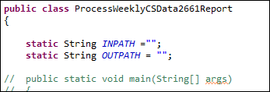
Required Python Changes for Output
BOT Guideline – Java
Jar file name should not contain any Blank spaces and Special characters (Can use underscore).
Your Java class code should not be contains main(String[] args) method.
Your main code will start from doProcess() method.
Return type of doProcess() method will be int type.
doProcess() method should accept 2 arguments.
Developer has to define two global variables as shown in below image.

Slide 16
Required Python Changes for Output
Required Changes for Java
BOT Store uses its set of defined jar files, before creating your final jar file, make sure you are using defined jar files.
If you are using extra jar files or different version of Jar files, First you need to confirm from BOT Store Support Team.

Slide 17
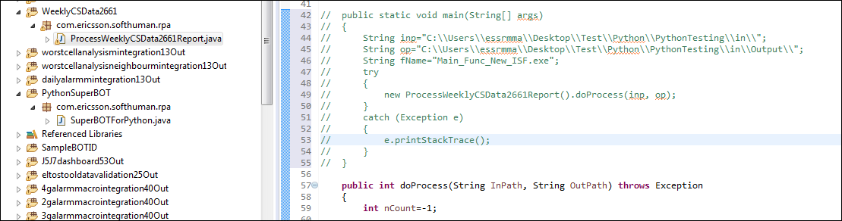
Required Python Changes for Output
Required Changes for Java
Package Name : com.erricson.softhuman.rpa
Should Not Contains Main() Method
Your doProcess Method signature should be as shown above

Slide 18
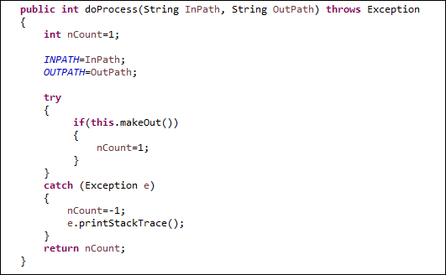
Required Python Changes for Output
Required Java Changes for Input / Output
Need to remove all hardcode Input and Output Paths from your code.
As shown in above images, please changes your hard coded path accordingly. And make changes in your complete code to remove hard coded path for input and output path.
Return Type int. In case of any error return value should be -1.
Save all output file using OUTPATH variable

Slide 19
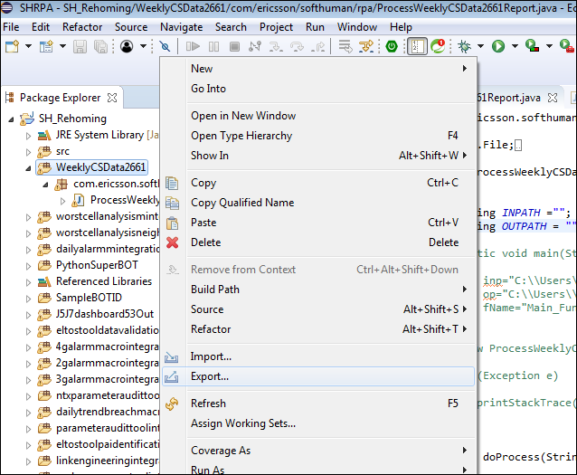
Required Python Changes for Output
Required Java Changes for Jar Creation
Now after above changes, you have to create jar file, using following steps:
Step 1
Step 2
Step 1: Right click on specified folder, not on main project.
Step 2: Click on Export option on menu.

Slide 20
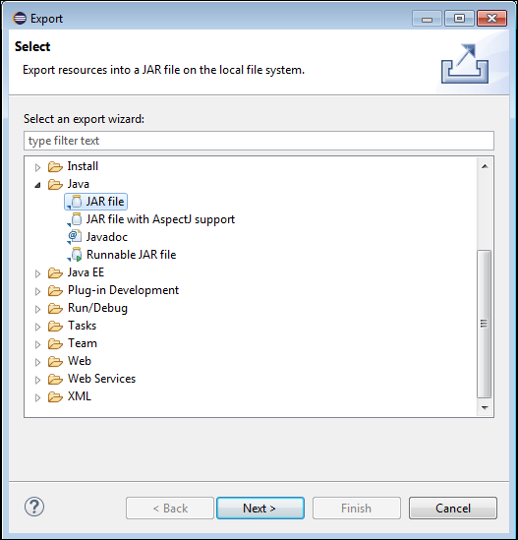
Required Python Changes for Output
Required Java Changes for Jar Creation
Step 3
Step 4
Step 3: Click on JAR file option.
Step 4: Click on Next Button.

Slide 21
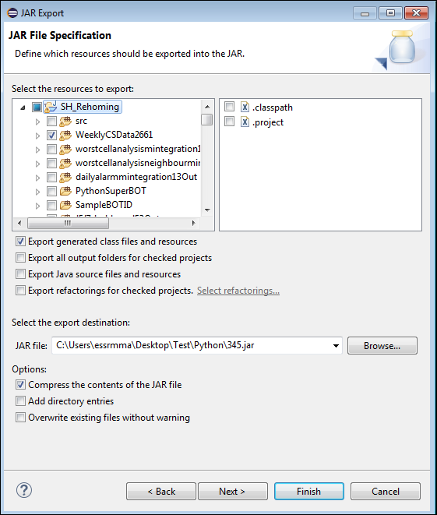
Required Python Changes for Output
Required Java Changes for Jar Creation
Step 5
Step 6
Step 7
Step 5: Reconfirm you have selected only required folder with classes (do not select supporting jar files).
Step 6: Check the option of Export generated class files and resources.
Step 7: Put your jar file name with path.
Step 8: Click on Finish Button to generate required jar file.
Step 8

Slide 23
ISF Test Environment – BOTs
Below Test environment is available for integration testing of BOTs in case anyone needs
http://10.184.56.132/ISF_UI_PreProd/
There is a separate ISF Desktop file for Preprod. It can be downloaded from below URL
http://10.184.56.132/isfupload/Setup/ISF/1.6/ISFSHSetup_PreProd_27092018.zip

